Slide 1
Angular – Custom Elements
Peter Eijgermans peter.eijgermans@ordina.nl

Slide 2
Custom Elements = WebComponent

Slide 3
What is a Custom Element and Shadow DOM?
With Custom Elements you can create your custom HTML tags !
With Shadow DOM you can encapsulate the View/DOM tree and CSS styles used inside your components behind your custom elements

Slide 4
Custom Elements = Future-proof
Building your web app using custom elements will make it future-proof
Why?
It will use standardized native browser APIs
Guaranteed to exist for decades and not depend on one framework or library

Slide 5
Custom Elements in Angular
Why in Angular?
This will allow you to use Angular features
Can be reused not just inside an Angular projects but in any JavaScript app
Future proof
Notes:
Popular high profile websites like YouTube are built completely with web components.

Slide 6
What are Angular Elements?
Transforms your Angular components to custom elements
in a framework-agnostic way

Slide 7
How to make a Custom element in Angular?
CreateCustomElement API → transform Angular component to a custom element
ViewEncapsulation API -> to create a shadow DOM and scoped styles

Slide 8
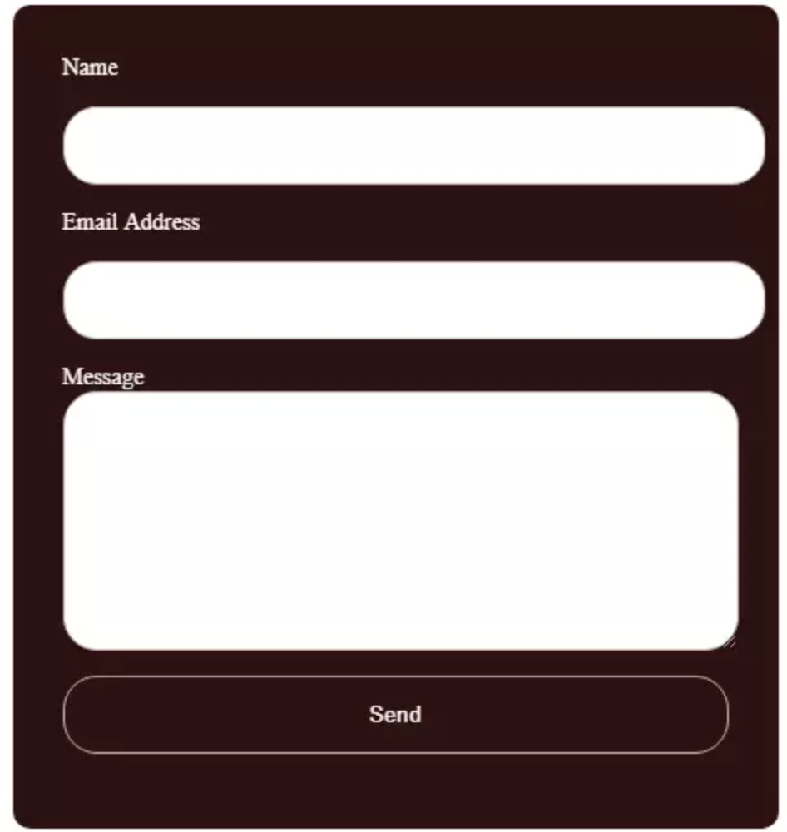
Tutorial
Built a reusable ‘contact form’ as an Angular component and export it as a custom element that can be used with JavaScript.

